Slide 1
Discriminant Analysis
Backhaus K, B Erichon, S. Gensler, R. Weiber, T. Weiber, Multivariate Analysis – An Application Oriented Introduction, 2nd ed., Springer Gabler, 2023
Johnson, R. A., Wishern, D. W., Applied Multivariate Statistical Analysis, sixth ed., Pearson, 2024

Slide 2
Introduction:
Whether multiple causes that are metric in nature influence two or more different mutually exclusive outcomes
How do voters choose different political parties?
Draw a random sample of voters of the different parties, and collect socio-demographic, psychographic, and attitudinal data.
Pyschographic: Study of people's psychological traits and behaviors - their attitudes, values, and interests. It's a market research method that helps businesses understand their customers and target them more effectively

Slide 3
Variables
The party of choice by the voter is a categorical (nominal) variable.
The party choice nominal variable may take values of different categories that are mutually exclusive (ME).
ME means that is, each person can be assigned to choose one specific party.
The metric variables used to correlate with the decision i.e., influence the decision may be voters age, income, consumption orientation, or attitude towards technology.

Slide 4
Process of Discrimination
Variables: Attitude towards technology, age, income, and consumption orientation
These variables are assumed to be metrically scaled
With the help of discriminant analysis, we identify which of the variables that describe the voters discriminate the supporters of different parties
Discrimination: Process of making distinctions between people based on the groups, classes, or other categories to which they belong or are perceived to belong such as race, gender, age, class, or religion
Data analyst chooses which of the describing variables are relevant/significant

Slide 5
Process of Discrimination
Discriminant analysis: Multivariate data analysis technique
Analyze the relationship between ONE categorical dependent variable and a set of metric (normally distributed) independent variables
The categorical variable (CV) is the grouping variable as its values leads to differentiating between the various groups
CV reflects the group (e.g., party) an observation (i.e., voter) belongs to,
Other examples, are buyers of different brands, or firms with different performances.
For just two categoric groups, the technique is called two-group discriminant analysis
For > 2 categoric groups, the technique is multi-group discriminant analysis

Slide 6
Application of Discriminant Analysis
We can apply discriminant analysis to identify describing (independent) variables that discriminate between different groups
It is also used to assess the discriminatory power of the describing variables (discrimination task).
Next, we apply discriminant analysis to predict the group membership of new observations based on the describing variables once we know which describing variables distinguish the members of the groups (classification task).

Slide 7
Example: Credit Scoring
Customers of a bank who have taken a loan may be divided into ‘good’ and ‘bad’ customers according to their payment behavior.
Using DA, we examine which variables (e.g., age, marital status, income, duration of current employment, or number of existing loans) differ between the two groups
Thus, we identify the set of discriminatory variables
When a new customer applies for a loan, the bank predicts his/her creditworthiness based on his/her attributes viz. age, marital status, income, duration of current employment, or number of existing loans

Slide 8
Six Step Procedure in DA: First Step
We first define the groups and, thus, the categories of the dependent variable
We then specify one or more discriminant functions, which are linear combinations of the independent variables that best discriminate between the groups.
If the grouping variable represents just 2 groups, we specify 1 discriminant function.
If we observe three or more groups, we use more than one discriminant function.

Slide 9
Six Step Procedure: Further Steps
We estimate the discriminant function(s).
We assess the discriminatory power of the estimated discriminant function(s)
We examine the discriminatory power of the describing (independent) variables and assess which describing variables contribute the most to explaining the differences between the groups.
We describe how (new) observations are classified to one of the groups based on the observed values of the describing variables.
Finally, we test the assumptions of the discriminant analysis.

Slide 10
Six Step Procedure: Further Steps
A manager of a chocolate company wants to know whether the buyers of its own brand (here: focal brand) perceive its chocolates differently compared to the buyers
of its main competitor brand.
The manager considers two describing variables to be relevant: ‘price’ and ‘delicious’.
We examine 12 buyers of the focal brand and 12 buyers of the main competitor brand.
All 24 respondents provided information about their perceptions using a 7-point scale (from 1 = ‘low’ to 7 = ‘high’).

Slide 11
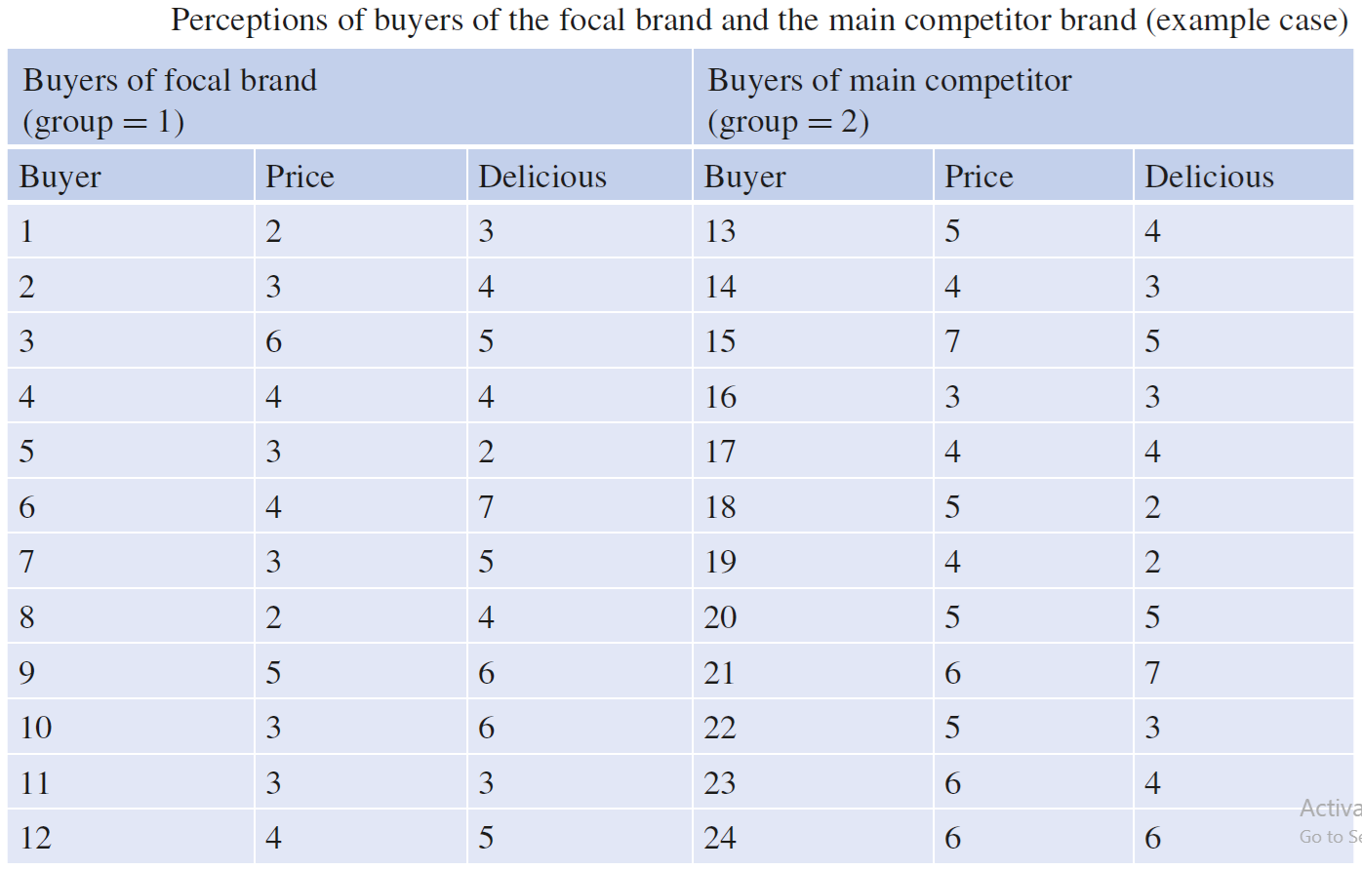
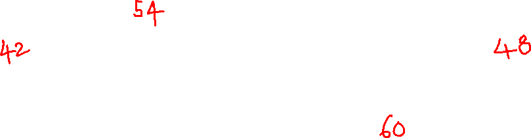

Slide 12
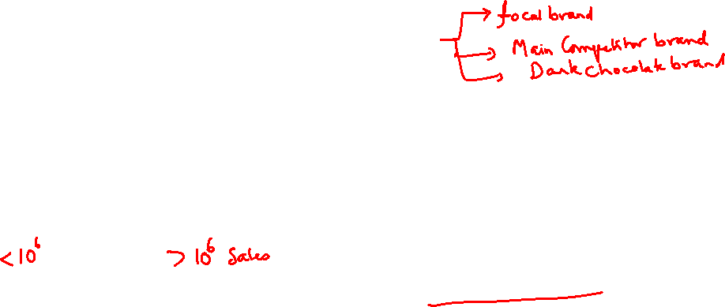
Definition of Groups
The grouping variable must be a categorical variable
It should reflect different mutually exclusive and collectively exhaustive groups.
We can also convert a metric variable (e.g., a firm’s profit) into a categorical variable (e.g., low vs. high performance) to form the grouping variable.
However, we need to be aware that we lose information if we do so.

Slide 13

Definition of Groups
Generally, the number of groups should not be larger than the number of describing variables.
In the example above, we have two describing variables, namely ‘price’ and
‘delicious’.
Thus, we restrict the example to two groups: ‘buyers of the focal brand’ and ‘buyers of the competing brand’.
The groups are identified by a group index g (g = 1, 2, …, G), where G is the total number of groups (here: G = 2 and g = 1, 2).

Slide 14
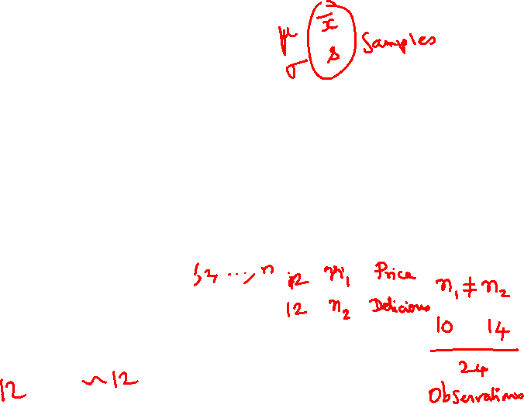
Recommendations related to the minimum number of observations
It is important to note that the reliability of the discriminant analysis depends on the number of observations.
We should have at least five observations per describing variable; 20 observations per describing variable are recommended.
Moreover, each group should have at least 20 observations to warrant statistically significant and reliable results.
Finally, the relative sizes of the groups should be comparable.

Slide 15
Number of Observations Within the Group
If for all features within a group, the number of entries is the same, say 10, the number of observations n is equal to number of entries, i.e., 10
But, if the number of entries for the features within a group is different number of entries, say 10 and 12, what is then the total number of observations?
The common answer is that the features may not have missing information. Either delete extra data or impute missing data seems to be the consensus. We will again look more closely when we handle actual data to see why this is true.

Slide 16
Number of Observations Across the Groups
If for all features across groups, the number of entries may be different, say 10 in group 1 and 12 in group 2
However, the number of observations may not be too different across groups
The condition is all features should be represented in each of the groups
All groups should have the same features

Slide 17
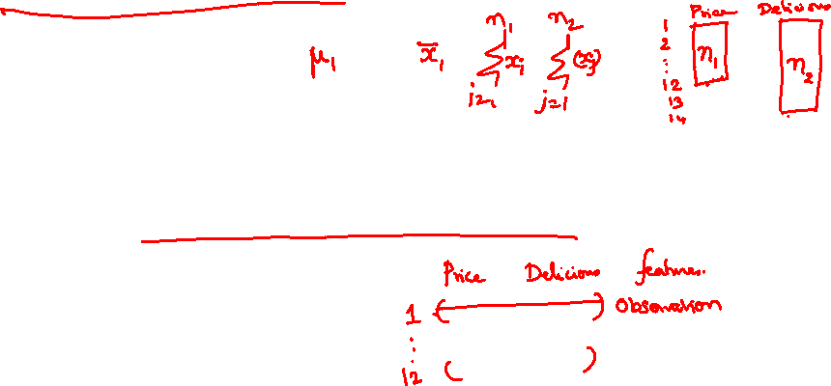
Recommendations related to the minimum number of observations
Large differences in the relative group sizes will influence the estimation of the discriminant function(s) and the classification of the observations.
Regarding these considerations, the groups in our example are actually rather small (only 12 observations for each group), but they are just meant as an illustrative example.

Slide 18
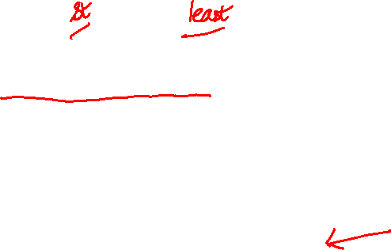
Participants Doubt: Ordinal to Metric
In choosing a chocolate brand, customers rate taste and price in a 1 to 7 scale which is an ordinal variable. How can it be used as a metric variable in linear discriminant analysis?
Treat 1 - 7 ordinal scale as a metric variable by directly using the numeric values (1 through 7) assuming the steps between numbers represent equal intervals.
We assume 7 is more and 1 is less (rating not ranking)
Scales with 5 or more categories (like 1 to 7) behave very similarly to continuous interval data in statistical practice
Option available to mathematically convert ordinal categories into optimized metric values before applying LDA (needs to be explored)

Slide 19
Participants Doubt: Ordinal to Metric
In choosing a chocolate brand, customers rate taste and price in a 1 to 7 scale which is an ordinal variable. How can it be used as a metric variable in linear discriminant analysis?
It is obviously an approximation
There are several ordered categories (e.g., 7 rather than only 2–3).
The categories are reasonably evenly spaced.
The distribution is not extremely skewed. If the rating distribution for both taste and price is unimodal, relatively symmetrical, and lacks extreme skewness
The sample size is reasonably large.
The analysis is intended to capture an approximately linear relationship.

Slide 20
Participants Doubt: Clustering vs. LDA
The main difference is that clustering is an unsupervised learning method that groups data without any pre-defined labels, while discriminant analysis is a supervised learning method that builds a model to classify items into pre-existing, known groups
Discriminant analysis is supervised (requires a training dataset with known group memberships).
Group Definition: In clustering, the number of groups and their identities are unknown ahead of time.
In discriminant analysis, the groups are completely defined before the analysis begins.
Primary Goal: Clustering aims to discover natural, hidden structures or segments in data. Discriminant analysis aims to find prediction equations or rules that best separate known groups and classify new observations.

Slide 21
Participants Doubt: Clustering vs. LDA
Cluster Analysis: It measures the distance or similarity between data points to maximize internal similarity (within groups) and external difference (between groups).
Common use case: Customer segmentation or finding natural groupings in unlabelled survey data.
Discriminant Analysis: Uses a known dependent grouping variable to find which independent variables best distinguish between the categories.
How it works: It analyzes a training set where group membership is already known, creating a mathematical function to separate the classes.
Common use case: Predicting whether a student will succeed based on past records or diagnosing medical outcomes from historical patient data.

Slide 22

The Discriminant Function
The discriminant function is a linear combination of the describing variables:
Y = b₀ + b₁X₁ + b₂X₂ + . . . + b_{J} X_{J}
Where
Y: dependent variable (grouping variable)
• b₀: constant term
• b_{j}: discriminant coefficient of the independent (describing) variable j
• X_{j}: independent (describing) variable j

Slide 23



Discriminant function
Y = b₀ + b₁X₁ + b₂X₂ + . . . + b_{J} X_{J}
The discriminant function is also called canonical discriminant function
The discriminant variable Y is called canonical variable
The term canonical indicates that the variables are combined linearly.
It is thus assumed that the relationship between the independent and dependent variables is linear.
For each observation that is described by some variables, the discriminant function predicts a value for the discriminant variable Y.

Slide 24
Discriminant function
Y = b₀ + b₁X₁ + b₂X₂ + . . . + b_{J} X_{J}
The discriminant function is also called canonical discriminant function
In this context, "canonical" refers to the fact that the discriminant function is derived in a standardized, optimal mathematical form
The discriminant variable Y is called canonical variable
The term canonical indicates that the variables are combined linearly

Slide 25
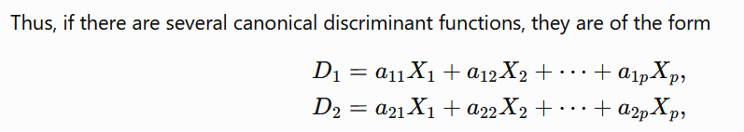
Discriminant function
Y = b₀ + b₁X₁ + b₂X₂ + . . . + b_{J} X_{J}
The discriminant variable Y is called canonical variable
In canonical discriminant analysis, canonical means that the analysis finds special (optimal) linear combinations of the original variables that maximize the separation among the groups and are mutually uncorrelated (orthogonal)

Slide 26
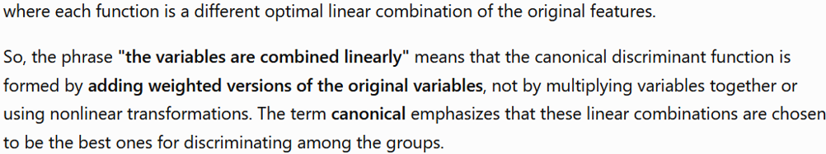
Discriminant function

Slide 27
Canonical Linear Discriminant function
The term signals that this particular linear combination isn't arbitrary —
it's the optimal one, derived mathematically
Among all possible linear combinations of the variables, the canonical discriminant function is the one that best separates the groups.
If there are more than two groups, additional canonical functions (orthogonal to the first) can be extracted, each capturing progressively less of the remaining group separation — analogous to how canonical correlation or principal components extract successive "best" linear combinations.
In short: "Linear" tells you the mathematical form (a weighted sum, no curves or interactions), and "canonical" tells you that this specific weighted sum is the statistically optimal one for discriminating between the groups.

Slide 28
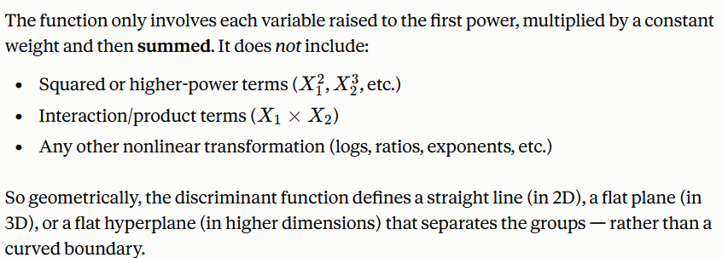
Why Linear Matters?

Slide 29
Why Linear Matters?
The function only involves each variable raised to the first power, multiplied by a constant weight and then summed.
It does not include: Squared or higher-power terms (X₁²​, X₂³​,etc.), Interaction/product terms (X₁X₂), any other nonlinear transformation (logs, ratios, exponents, etc.)
So geometrically, the discriminant function defines a straight line (in 2D), a flat plane (in 3D), or a flat hyperplane (in higher dimensions) that separates the groups — rather than a curved boundary.

Slide 30
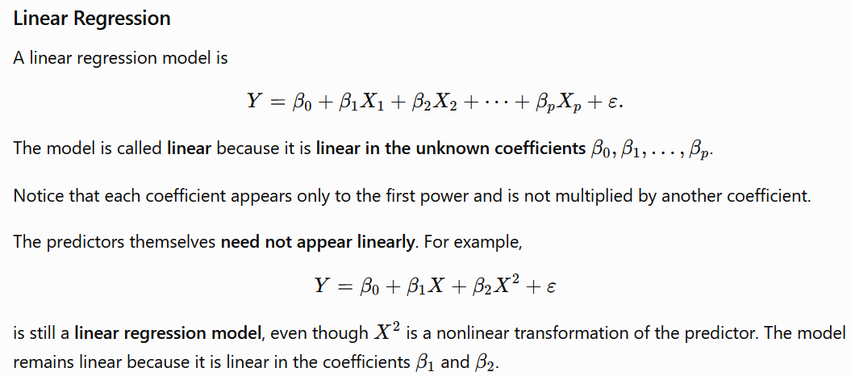
Why Linear Matters?
In Linear Regression we focus on the linearity of the regression coefficients
In Linear Discriminant Analysis, we focus on the linear combination of the predictors/independent variables

Slide 31
Why Linear Matters?
In Linear Regression we focus on the linearity of the regression coefficients
In Linear Discriminant Analysis, we focus on the linear combination of the predictors/independent variables

Slide 32
Discriminant function
Y = b₀ + b₁X₁ + b₂X₂ + . . . + b_{J} X_{J}
The coefficients b₀ and b_{j} (j = 1, 2, …, J) are estimated based on the observed data in such a way that the groups differ as much as possible with respect to the values of the discriminant variable Y.
Since the describing variables are metric, the resulting discriminant variable Y is also metric and does not directly indicate the group membership
How estimates of group membership are derived from the estimated value of the discriminant variables such as Y forms the scope for succeeding discussion

Slide 33
Estimation of the Discriminant Function
Y = b₀ + b₁X₁ + b₂X₂ + . . . + b_{J} X_{J}
When estimating the unknown coefficients b₀ and b_{j} of the discriminant function, the objective is to identify all b_{j} in such a way that they separate the groups well.
This requires an
objective function / criterion
that maximizes the
separation of the groups (discriminant criterion).

Slide 34
Discriminant Criterion
Discriminant analysis aims to identify the describing variables that discriminate the groups.
This implies that the groups differ with respect to the describing variables
If they do so, we should observe different values for the describing variables in the two groups of the example presented above.
Figure below displays a scatterplot of the observed values of the describing variables.
The buyers of the focal brand are represented by red squares and the buyers of the main competitor brand by black asterisks.

Slide 35
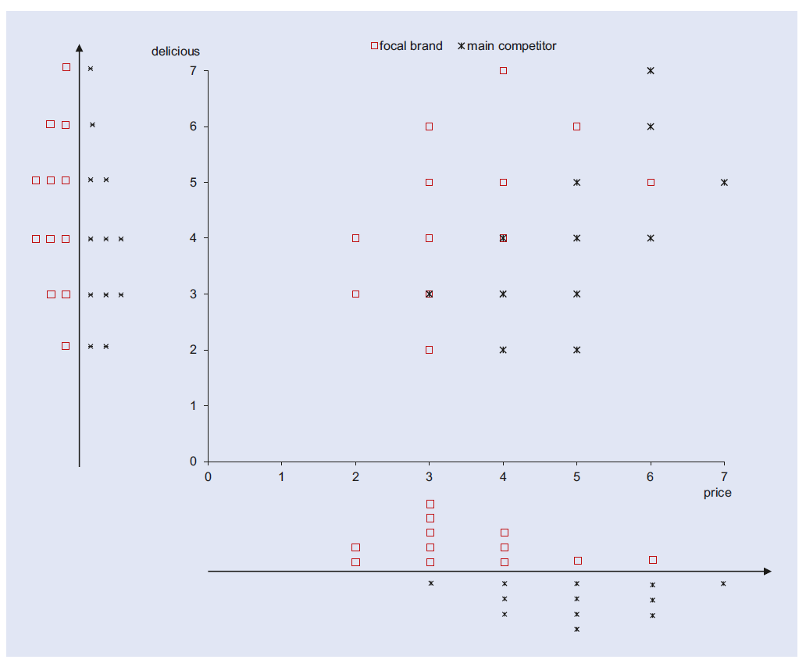

Scatter Plot of the Observed Data

Slide 36
Discriminant Criterion
Figure also shows the frequency distributions (histograms) of the values of the describing variables (i.e. ‘price’ and ‘delicious’) below (‘price’) or beside (‘delicious’) the scatterplot.
The frequency distribution for each group is displayed separately, and the axes correspond to the original x- and y-axes.
We learn that buyers of the competing brand tend to rate ‘price’ higher than buyers of the focal brand (cf. histogram below the scatterplot).

Slide 37
Discriminant Criterion
The respective mean values of ‘price’ are 5.0 (competitior) and 3.5 (focal).
In contrast, buyers of the focal brand rate, on average, rate ‘delicious’ higher than the buyers of the main competitor brand (mean values: 4.5 focal vs. 4.0 competitor) –refer histogram beside the scatterplot
However, due to the significant overlaps of the two distributions, neither variable seems to separate the two groups very well
Visual inspection of the histograms suggests that ‘price’ may separate the groups better because the groups seem to differ more with respect to this variable

Slide 38

Mathematical Theory: Basics
(1) separating two classes of objects or
(2) assigning a new object to one of two classes.
It is convenient to label the classes π₁ and π₂ and the categories are ordinarily separated or classified on the basis of measurements on, for instance, p associated random variables
The observed values of X differ to some extent from one class to the other.
We can think of the totality of values from the first class as being the population of x values for π₁ and those from the second class as the population of x values for π₂

Slide 39
Alternate Approach: Basics
These two populations can then be described by probability density functions and
Consequently, we can talk of assigning observations to populations or objects to classes interchangeably.

Slide 40
Problems of Misclassification
Another aspect of classification is cost.
Suppose that classifying an object as belonging to π₂ represents a more serious error than classifying an object as belonging to π₁, then one should be cautious about making the former assignment.
As an example, failing to diagnose a potentially fatal illness is substantially more “costly” than concluding that the disease is present when, in fact, it is not.
An optimal classification procedure should, whenever possible, account for the costs associated with misclassification.

Slide 41
Probability Distributions
Let f₁(x) and f₂(x) be the multivariate probability density functions associated with the p x 1 vector random variable X for the populations π₁ and π₂ respectively.
An object with associated measurements x must be assigned to either π₁ or π₂
Let Ω be the sample space—that is, the collection of all possible observations x.
Let R₁ be that set of x values for which we classify objects as π₁ and R₂ = Ω - R₁ be the set of remaining x values for which we classify objects as π₂
Since every object must be assigned to one and only one of the two populations, the sets R₁ and R₂ are mutually exclusive and exhaustive.
For we might have a case like the one pictured in Figure below

Slide 42
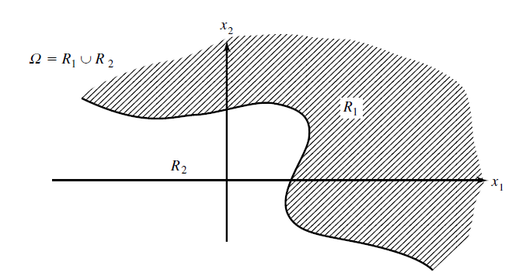
Classification regions for two populations

Slide 43


Probability of Misclassifications
The conditional probability, P(2|1) of misclassifying an object as π₂ when, in fact, it is from is π₁
Similarly, the conditional probability, P(1|2) of misclassifying an object as π₁ when, in fact, it is from π₂ is
The integral sign in first equation represents the volume formed by the density function f₁(x) over the region R₂
Similarly, the integral sign in the second equation represents the volume formed by f₂(x) over the region R₁
For the univariate case, p=1, this is illustrated in the figure given in the next slide

Slide 44
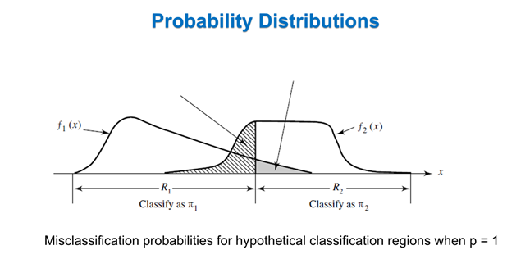
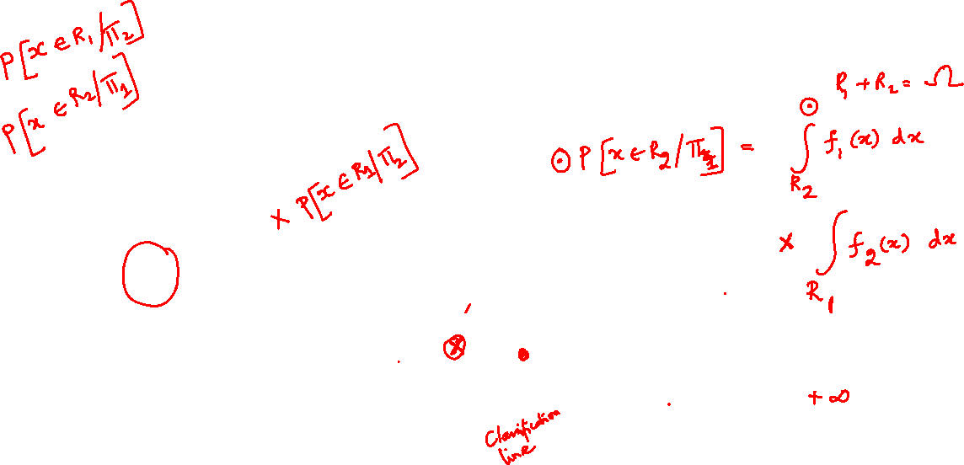


Slide 45
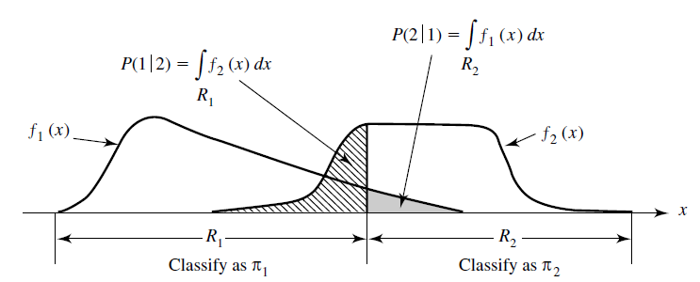
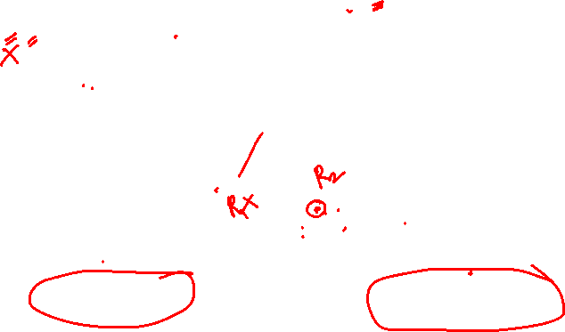
Probability Distributions
Misclassification probabilities for hypothetical classification regions when p = 1

Slide 46
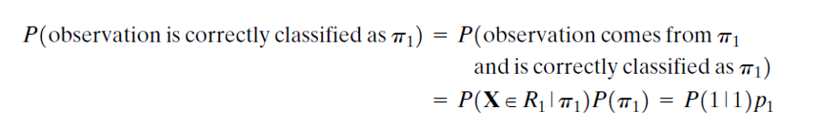
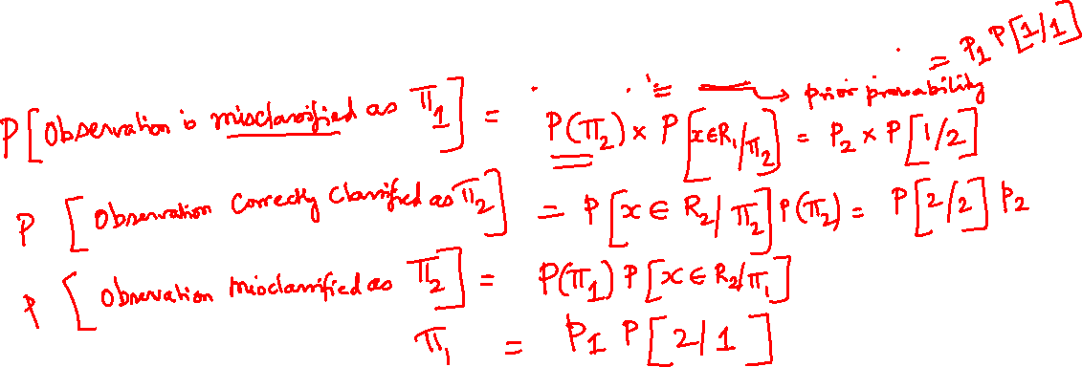
Probability Distributions
Let p₁ be the prior probability of π₁ and p₂ be the prior probability of π₂ , where p₁+p₂=1
Then the overall probabilities of correctly or incorrectly classifying objects may be derived as the product of the prior and conditional classification probabilities:

Slide 47
Probability Distributions

Slide 48
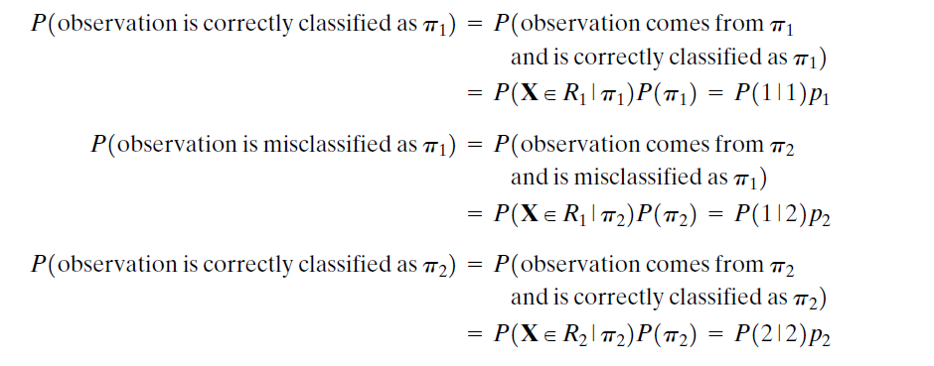
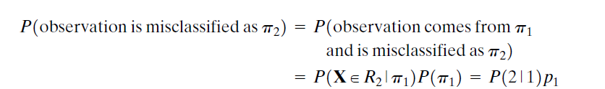
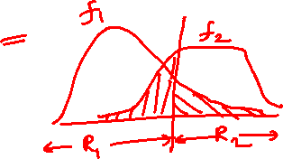
Probability Distributions
Let p₁ be the prior probability of π₁ and p₂ be the prior probability of π₂ , where p₁+p₂=1
Then the overall probabilities of correctly or incorrectly classifying objects may be derived as the product of the prior and conditional classification probabilities:

Slide 49
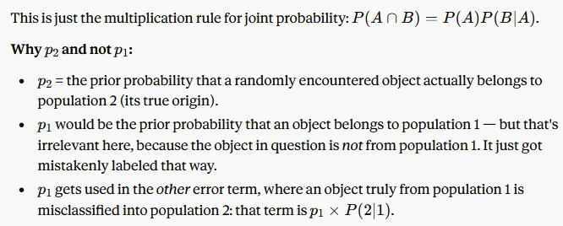
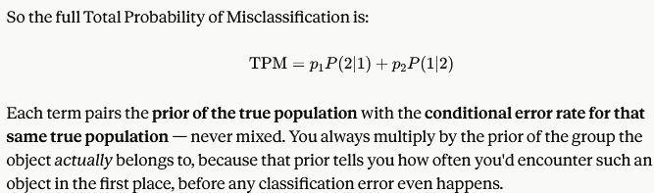

Slide 50
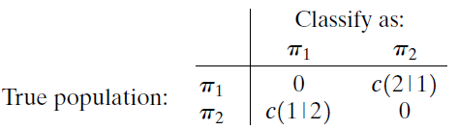
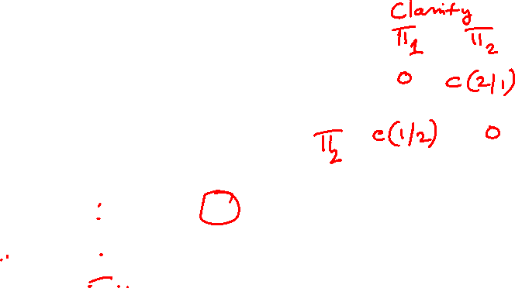

Cost of Misclassifications
Classification schemes are often evaluated in terms of their misclassification probabilities, but this ignores misclassification cost.
For example, even a seemingly small probability such as P(2|1) = 0.06, may be too large if the cost of making an incorrect assignment to is extremely high.
A rule that ignores costs may cause problems
The costs of misclassification can be defined by a cost matrix:

Slide 51

Probability Distributions
The costs are (1) zero for correct classification, (2) c(1|2) when an observation from π₂ is incorrectly classified as π₁ (3) c(2|1) when the observation belongs to π₁ but wrongly classified as π₂
The average or expected cost of misclassification (ECM) is provided by multiplying the off-diagonal entries in the above relations by their probabilities of occurrence. Here,
ECM = c(2|1)P(2|1)p₁+c(1|2)P(1|2)p₂
A reasonable classification rule should ensure ECM is as small as possible

Slide 52
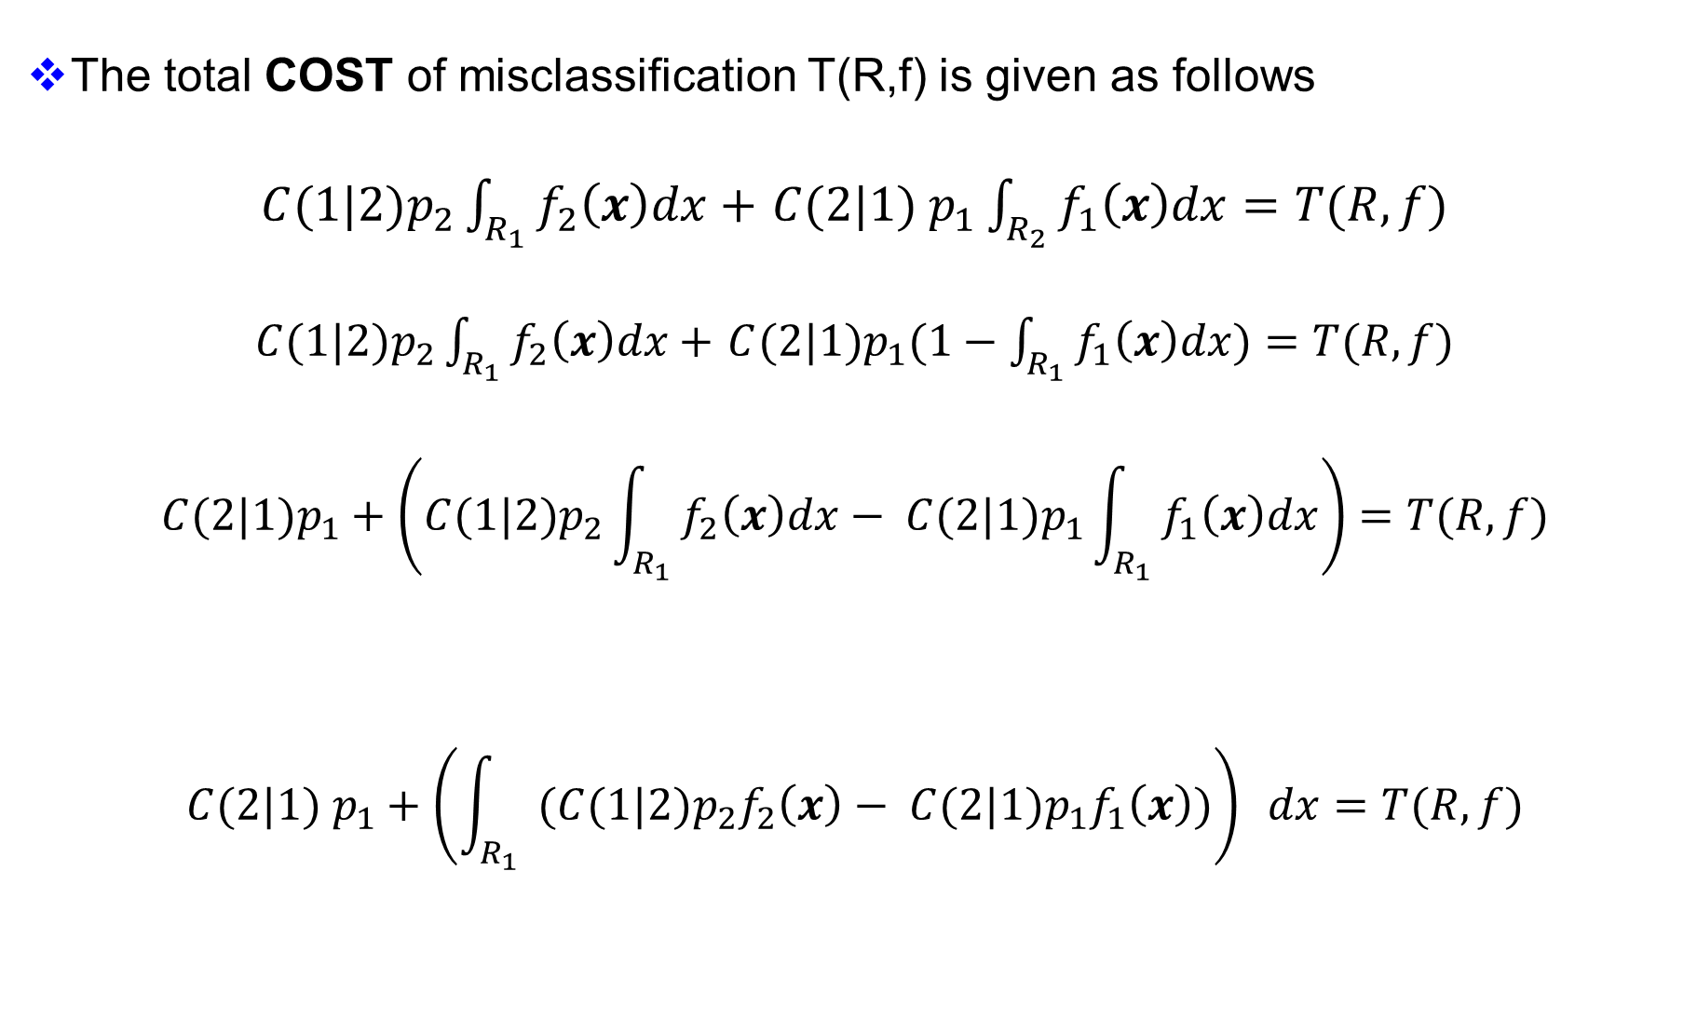
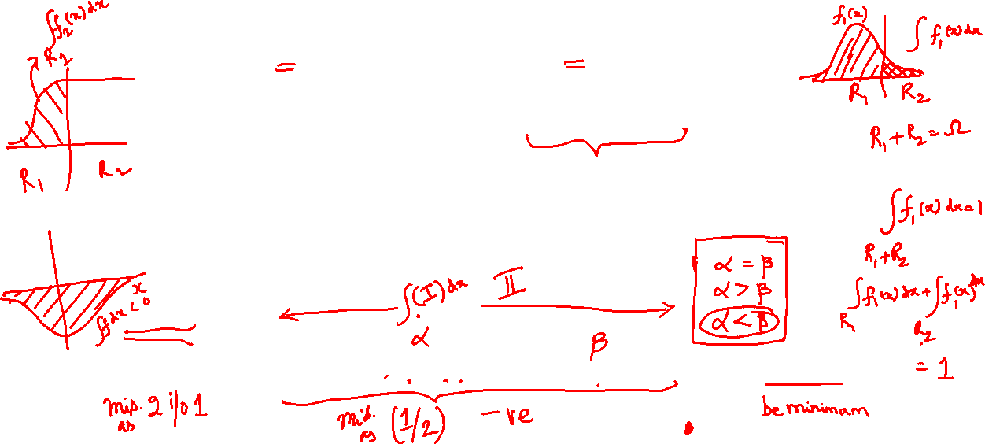
Explanation Accounting For Costs
The total COST of misclassification T(R,f) is given as follows
${C(1|2)p}_{2}\int_{R_{1}}{f_{2}\left(x\right)dx+}$ $C(2|1) p_{1}\int_{R_{2}}{f_{1}\left(x\right)dx}=T(R,f)$
${C(1|2)p}_{2}\int_{R_{1}}{f_{2}\left(x\right)dx+}$ ${C(2|1)p}_{1}(1−\int_{R_{1}}{f_{1}\left(x\right)dx})=T(R,f)$
$$C(2|1)p_{1}+\left(C(1|2)p_{2}\int_{R_{1}}{f_{2}\left(x\right)dx−} {C(2|1)p}_{1}\int_{R_{1}}{f_{1}\left(x\right)dx}\right)=T(R,f)$$
$$C(2|1) p_{1}+\left(\int_{R_{1}}{ ({C(1|2)p_{2}f}_{2}\left(x\right)−} {C(2|1)p}_{1}f_{1}\left(x\right))\right) dx=T(R,f)$$

Slide 53
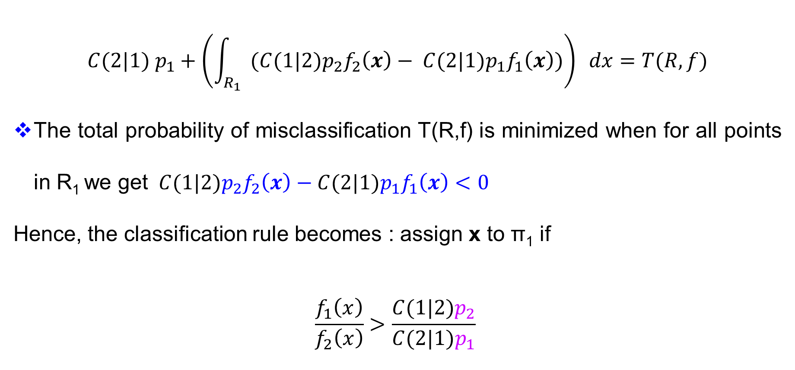
Explanation Accounting For Costs
$$C(2|1) p_{1}+\left(\int_{R_{1}}{ ({C(1|2)p_{2}f}_{2}\left(x\right)−} {C(2|1)p}_{1}f_{1}\left(x\right))\right) dx=T(R,f)$$
The total probability of misclassification T(R,f) is minimized when for all points in R₁ we get ${C(1|2)p}_{2}f_{2}\left(x\right)−{C(2|1)p}_{1}f_{1}\left(x\right)<0$
Hence, the classification rule becomes : assign x to π₁ if
$$\frac{f_{1}\left(x\right)}{f_{2}\left(x\right)}>\frac{C(1|2)p_{2}}{C(2|1)p_{1}}$$

Slide 54
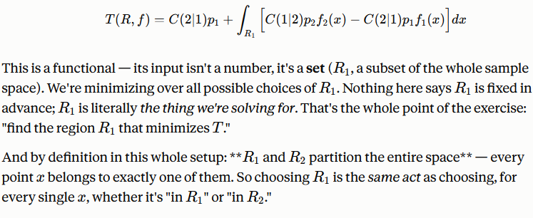
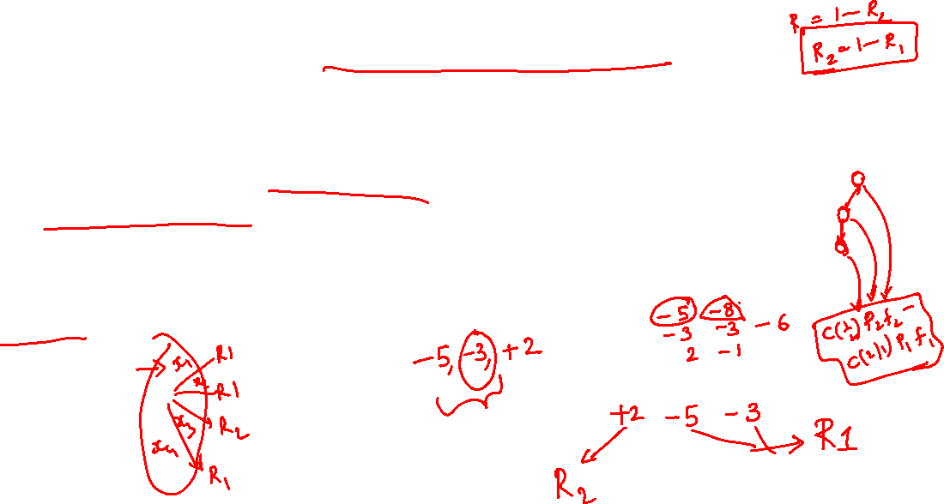
Explanation Accounting For Costs

Slide 55

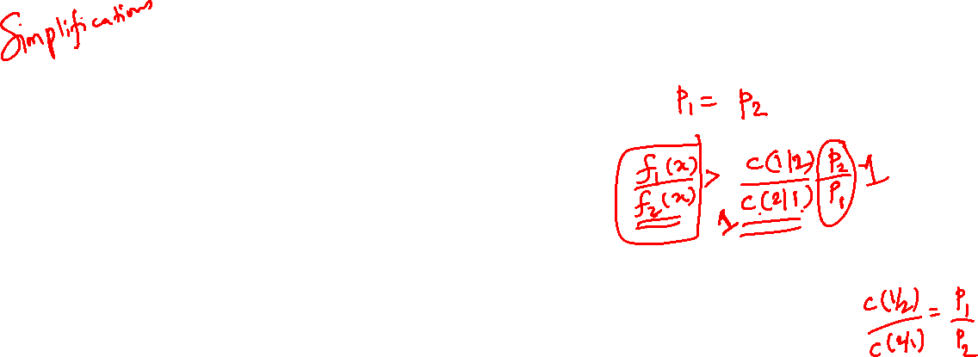
Probability Distributions
$$\frac{f_{1}\left(x\right)}{f_{2}\left(x\right)}>\frac{C(1|2)p_{2}}{C(2|1)p_{1}}$$
When the prior probabilities are unknown, they are often taken to be equal, and the minimum ECM rule involves comparing the ratio of the population densities to the ratio of the appropriate misclassification costs.
If the misclassification cost ratio is also indeterminate, it is usually taken to be unity, and the population density ratio is compared with the ratio of the prior probabilities.
Note that the prior probabilities are in the reverse order of the densities.
Finally, when both the prior probability and misclassification cost ratios are unity, or one ratio is the reciprocal of the other, the optimal classification regions are determined simply by comparing the values of the density functions.

Slide 56
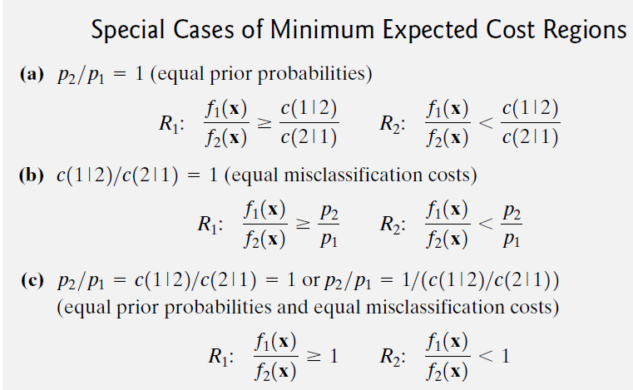
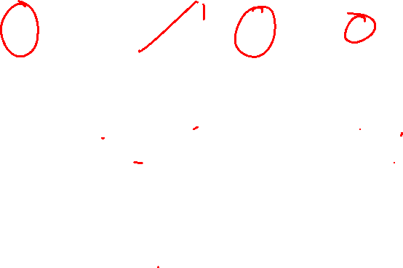

Slide 57
Probability Distributions
In this case, if x₀ is a new observation and f₁(x₀)/f₂(x₀) is ≥ 1, i.e., we assign x_{o} to π₁
On the other hand if f₁(x₀)/f₂(x₀) < 1, we assign x_{o} to π₂
It is common practice to arbitrarily use case (c) above for classification.
This is tantamount to assuming equal prior probabilities and equal misclassification costs for the minimum ECM rule
This is the justification generally provided.
It is also equivalent to assuming the prior probability ratio to be the reciprocal of the misclassification cost ratio.

Slide 58
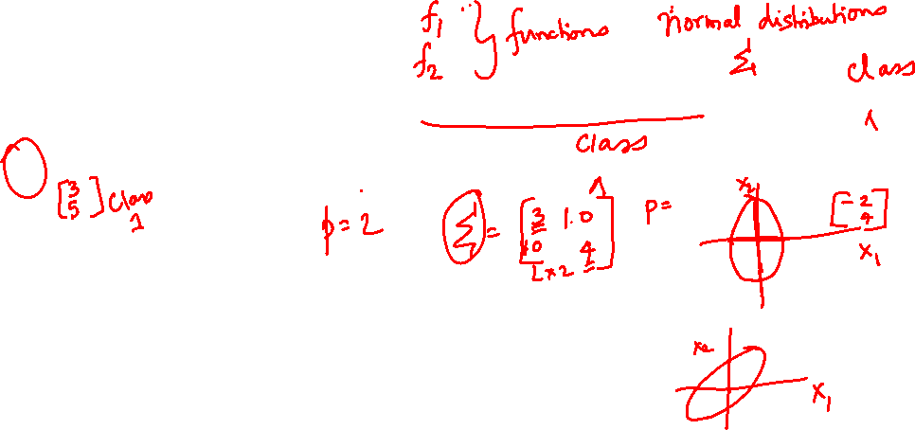
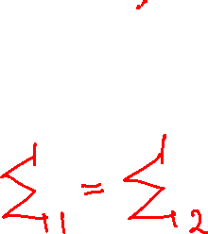

Classification with Two Multivariate Normal Distributions
Classification procedures based on normal populations predominate in statistical practice because of their simplicity and reasonably high efficiency across a wide variety of population models.
We now assume that f₁(x) and f₂(x) are multivariate normal densities, the first with mean vector µ₁ and covariance matrix ∑₁ and the second with mean vector µ₂ and covariance matrix ∑₂
The special case of equal covariance matrices leads to a particularly simple linear classification statistic.

Slide 59
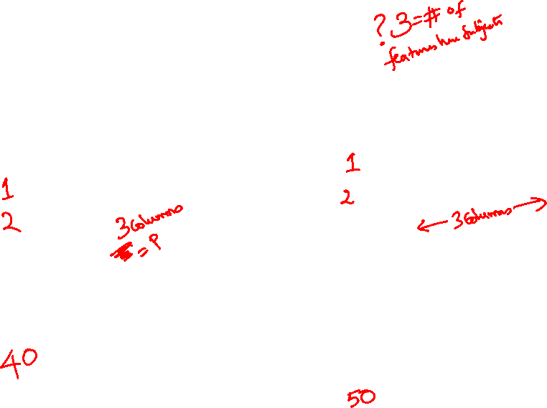
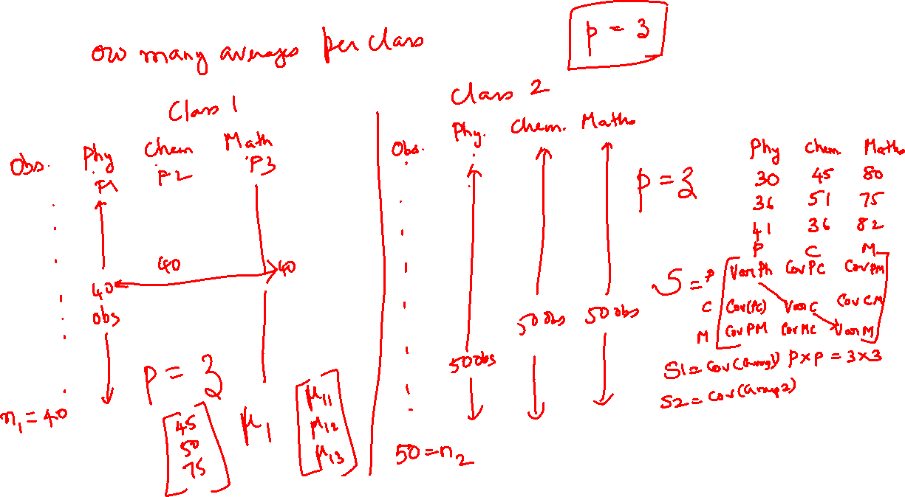

Slide 61
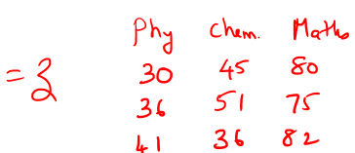

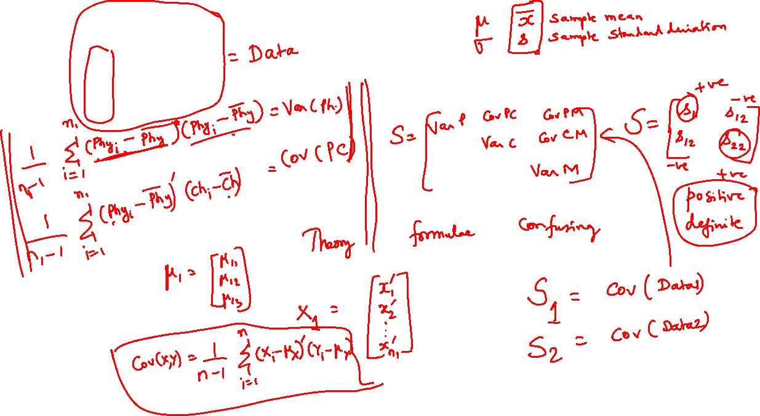

Slide 62
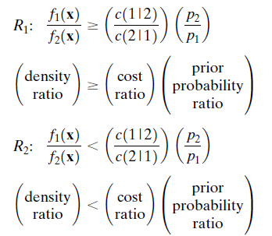
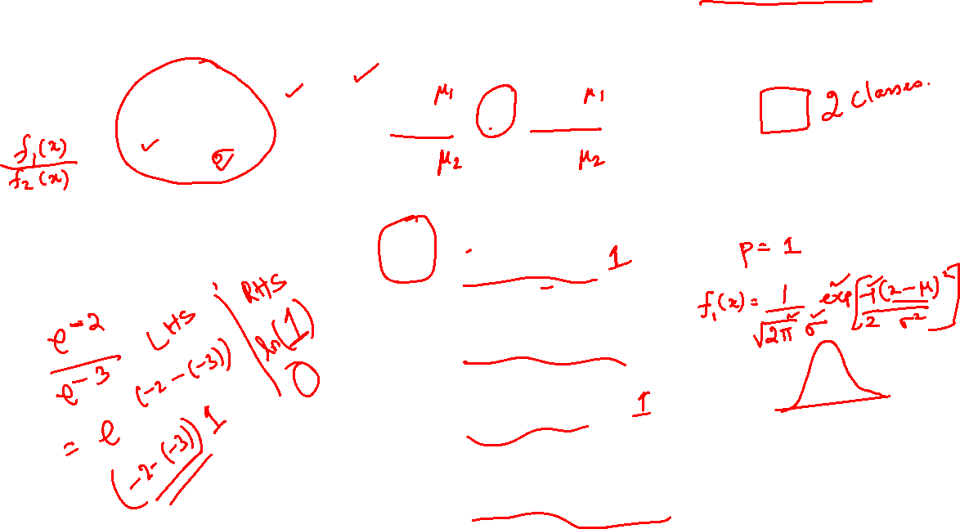
Classification of Normal Populations When ∑₁ = ∑₂ = ∑
Suppose that the joint densities of X for populations π₁ and π₂ are given by
Let us assume that the population parameters viz. µ₁ and µ₂ as well as ∑ are known.
Then using the following form

Slide 63
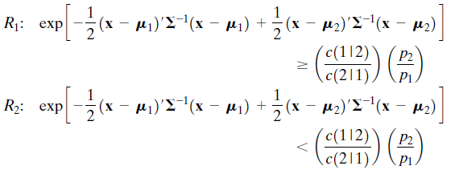
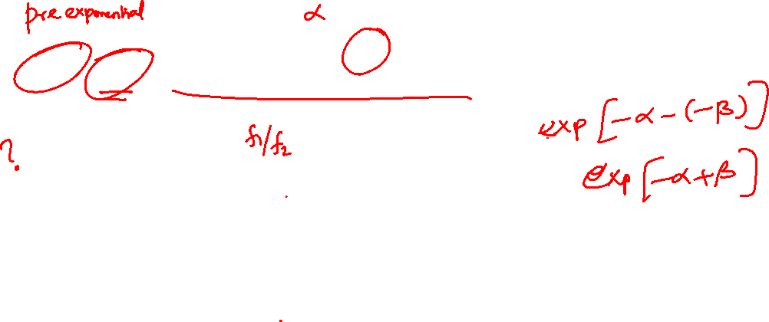
Classification of Normal Populations When ∑₁ = ∑₂ = ∑
Then the expected cost of misclassification becomes
Given these regions and we can construct the classification rule given in the following result.

Slide 64
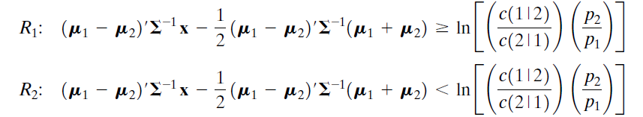
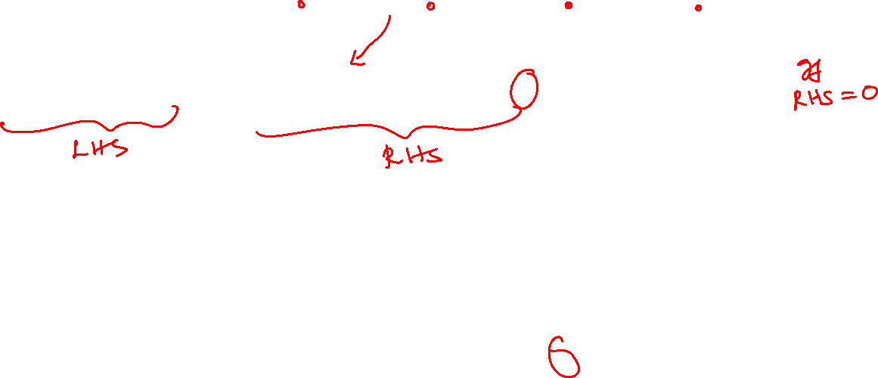
Classification of Normal Populations When ∑₁ = ∑₂ = ∑
Allocate x to π₁ if
Allocate x to π₂ otherwise

Slide 65
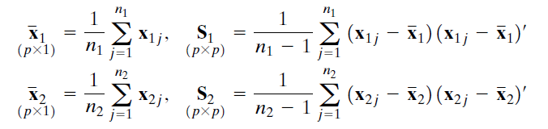
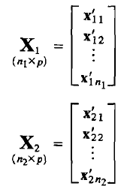
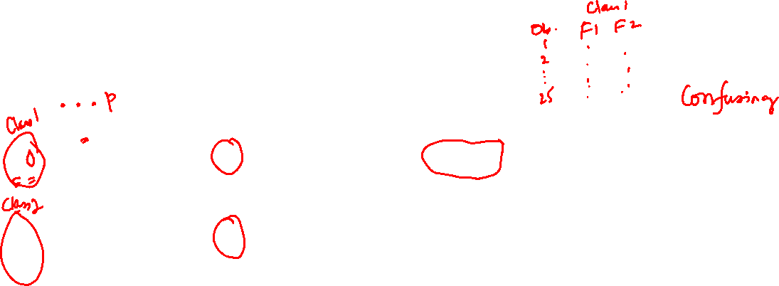
Classification with Two Multivariate Normal Distributions
In most practical situations, the population quantities and are unknown
So, the above rule must be modified.
It has been suggested replacing the population parameters by their sample counterparts.
From the data matrices we compute

Slide 66

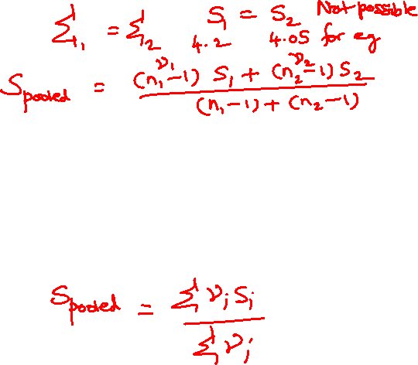
Classification with Two Multivariate Normal Distributions
Since it is assumed that the parent populations have the same covariance matrix ∑ the sample covariance matrices S₁ and S₂ and are combined (pooled) to derive a single, unbiased estimate of ∑.
In particular, the weighted average
is an unbiased estimate of ∑ if the data matrices X₁ and X₂ and contain random samples from the populations π₁ and π₁ respectively.

Slide 67




Classification with Two Multivariate Normal Distributions
Substituting ${\overline{x}}_{1}$for µ₁ and ${\overline{x}}_{2}$for µ₂ and S_{pooled} for ∑ gives the “sample” classification rule:

Slide 68





Classification with Two Multivariate Normal Distributions
If we set $\left(\frac{c\left(1 | 2\right)}{(c\left(2 | 1\right)}\right)∗\left(\frac{p_{2}}{p_{1}}\right)=1$ we find ln(1) =0 and then the above equation may be written as two parts after equating the following relation to 0.
= 0

Slide 69







Classification with Two Multivariate Normal Distributions
estimated minimum ECM rule for two normal populations
The estimated ECM rule amounts to comparing the scalar variable
with the
number (second part)

Slide 70


Classification with Two Multivariate Normal Distributions
= 0
estimated minimum ECM rule for two normal populations
The estimated ECM rule amounts to comparing the scalar variable
with the
number (second part)

Slide 71



Probability Distributions
That is, the estimated minimum ECM rule for two normal populations is tantamount to creating two univariate populations for the y values.
This is done by taking an appropriate linear combination of the observations from populations π₁ and π₂ and then assigning a new observation x_{o} to π₁ or π₂ depending upon whether ${\hat{y}}_{o}=\hat{a}′$x_{o} falls to the right or left of the midpoint $\hat{m}$ between the two-univariate means ${\overline{y}}_{1}$ and ${\overline{y}}_{2}$

Slide 72

Probability Distributions
Once parameter estimates are inserted for the corresponding unknown population quantities, there is no assurance that the resulting rule will minimize the expected cost of misclassification in a particular application
This is because the optimal rule was derived assuming that the multivariate normal densities f₁(x) and f₂(x) were known completely.
Expression
is simply an estimate of the optimal rule.
It is reasonable to expect that it should perform well if the sample sizes are large

Slide 73

Summary (End of Part 1)
To summarize, if the data appear to be multivariate normal, the classification statistic to the left of the inequality can be calculated for each new observation
These observations are classified by comparing the values of the statistic with the value of
$$\ln\left[\frac{c\left(1 | 2\right)}{c\left(2 | 1\right)}\left(\frac{p_{2}}{p_{1}}\right)\right]$$

Slide 74
Example Problem
Using the data given in the excel file do the following
Carry out the discriminant analysis
Obtain the sample linear discriminant function, assuming equal prior probabilities
Classify the following 10 new cases using the discriminant function in Part b.

Slide 75

New Data Set for Classification

Slide 76
Summary of Formulae Used

Slide 77

Summary of Formulae Used

Slide 78

Matlab Code For Discrimination
% Problem 11.8 in
clear all
clc
Group1 = [
-0.0056 -0.1657
-0.1698 -0.1585
-0.3469 -0.1879
…
0.1507 0.0933
-0.1259 -0.0669
-0.1551 -0.1232
-0.1952 -0.1007
…
-0.1972 -0.0607
-0.0867 -0.056 ];
Group2= [
-0.3478 0.1151
-0.3618 -0.2008
-0.4986 -0.086
…
-0.2444 0.1614
-0.4784 0.0282
];
div1=length(Group1);
div2=length(Group2);
x1bar=mean(Group1)';
x2bar=mean(Group2)';
S1=cov(Group1);
S2=cov(Group2);
n1m1=div1-1;
n2m1=div2-1;
Spooled=(n1m1/(n1m1+n2m1))*S1+
(n2m1/(n1m1+n2m1))*S2;
Spooledinv=inv(Spooled);
diffp=(x1bar-x2bar)';
ahatp = diffp*Spooledinv;
y1bar=ahatp*x1bar;
y2bar=ahatp*x2bar;
mhat=0.5*(y1bar+y2bar);

Slide 79
Matlab Code For Discrimination
% Problem 11.8 in
clear all
clc
Group1 = [
-0.0056 -0.1657
-0.1698 -0.1585
-0.3469 -0.1879
…
0.1507 0.0933
-0.1259 -0.0669
-0.1551 -0.1232
-0.1952 -0.1007
…
-0.1972 -0.0607
-0.0867 -0.056 ];
Group2= [
-0.3478 0.1151
-0.3618 -0.2008
-0.4986 -0.086
…
-0.2444 0.1614
-0.4784 0.0282
];
div1=length(Group1);
div2=length(Group2);
x1bar=mean(Group1)';
x2bar=mean(Group2)';
S1=cov(Group1);
S2=cov(Group2);
n1m1=div1-1;
n2m1=div2-1;
Spooled=(n1m1/(n1m1+n2m1))*S1+
(n2m1/(n1m1+n2m1))*S2;
Spooledinv=inv(Spooled);
diffp=(x1bar-x2bar)';
ahatp = diffp*Spooledinv;
y1bar=ahatp*x1bar;
y2bar=ahatp*x2bar;
mhat=0.5*(y1bar+y2bar);

Slide 80

New Data Set for Classification

Slide 81


Code For Classification
% Add following lines to previous code
% For classification New Test Data set
Test_Data = [
-0.112 -0.279
-0.059 -0.068
0.064 0.012
-0.043 -0.052
-0.05 -0.098
-0.094 -0.113
-0.123 -0.143
-0.011 -0.037
-0.21 -0.09
-0.126 -0.019];
Result = ahatp*Test_Data';
Score = Result-mhat;
for j=1:length(Test_Data)
if Score(j) > 0
Class(j) = 1;
else
Class(j) = 2;
end
end
Final_Outcome=[Test_Data Score' Class']
Final_Outcome =
-0.1120 -0.2790 6.1734 1.0000
-0.0590 -0.0680 3.5841 1.0000
0.0640 0.0120 4.5904 1.0000
-0.0430 -0.0520 3.6192 1.0000
-0.0500 -0.0980 4.2717 1.0000
-0.0940 -0.1130 3.6785 1.0000
-0.1230 -0.1430 3.6320 1.0000
-0.0110 -0.0370 3.9806 1.0000
-0.2100 -0.0900 1.0437 1.0000
-0.1260 -0.0190 1.4506 1.0000

